Slide 1
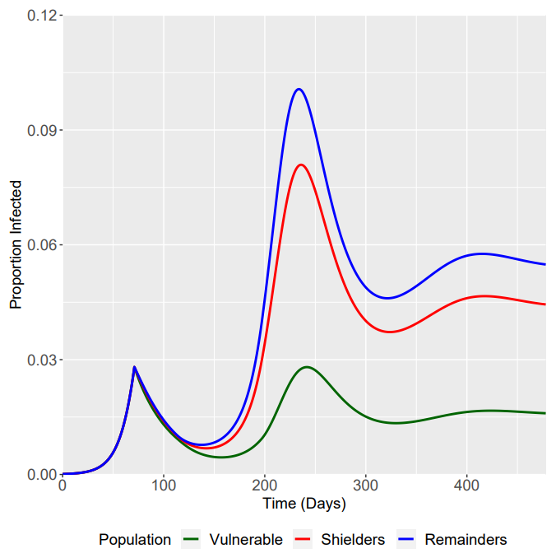
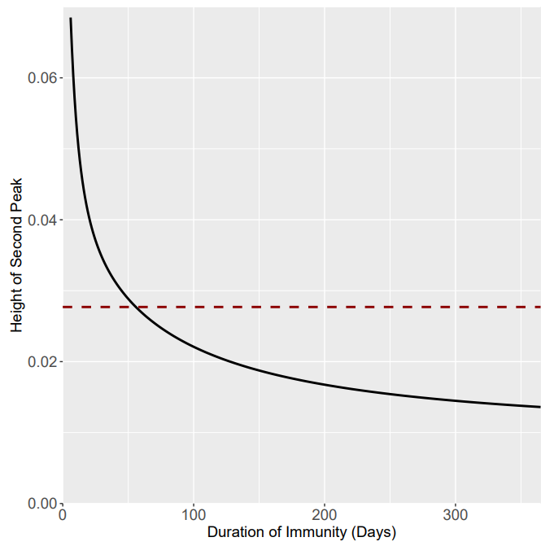
Using Central Beta Parameter Values
Relationship between Duration of Immunity and Height of Second Peak
Red line represents height of 1st peak
Minimum Duration of Immunity before Vulnerable I(t) 2nd Peak is greater than 1st Peak
54 Days or ζ = 1/54

Slide 2
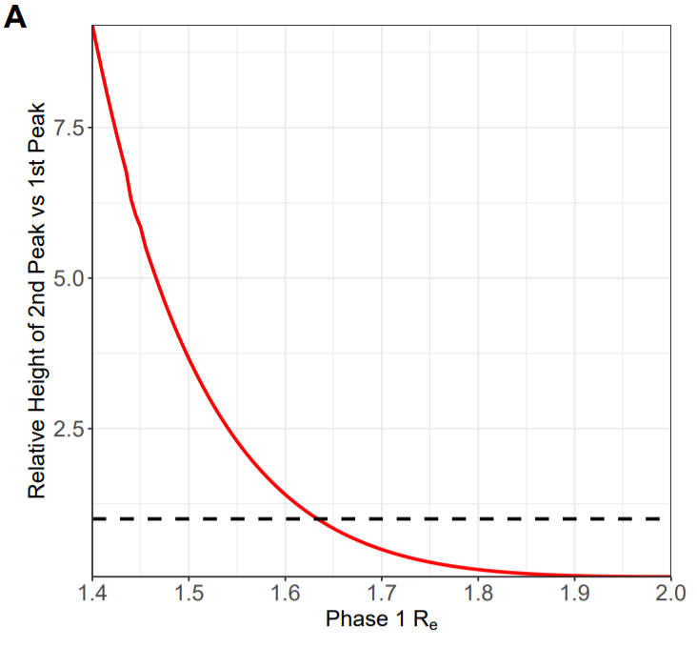
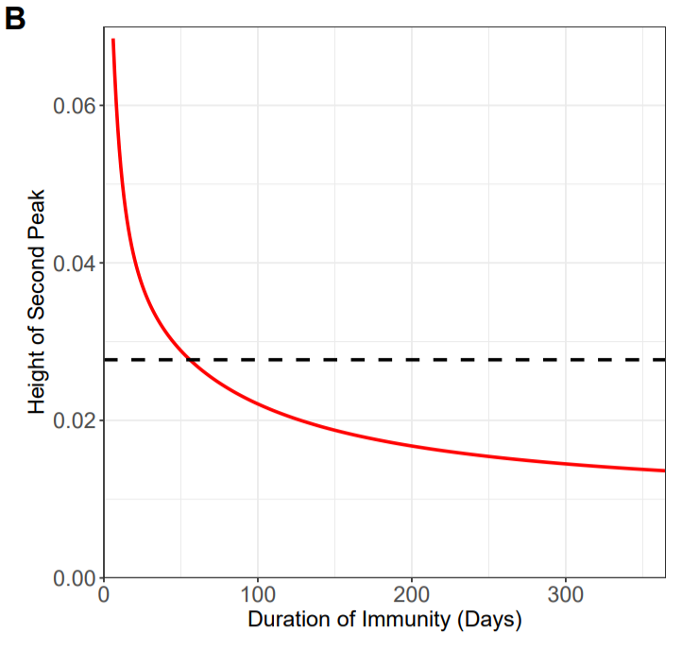
A

Slide 3
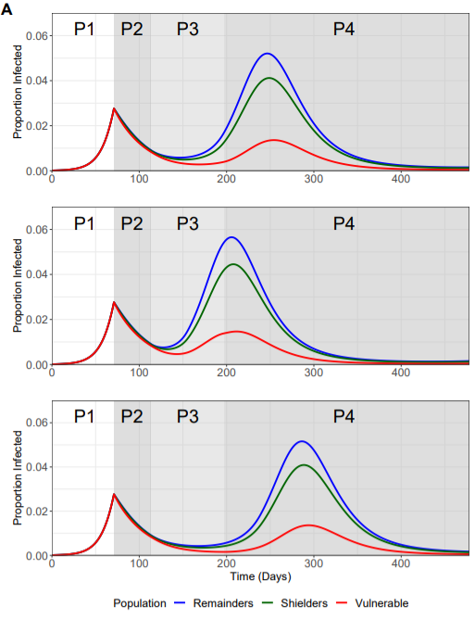
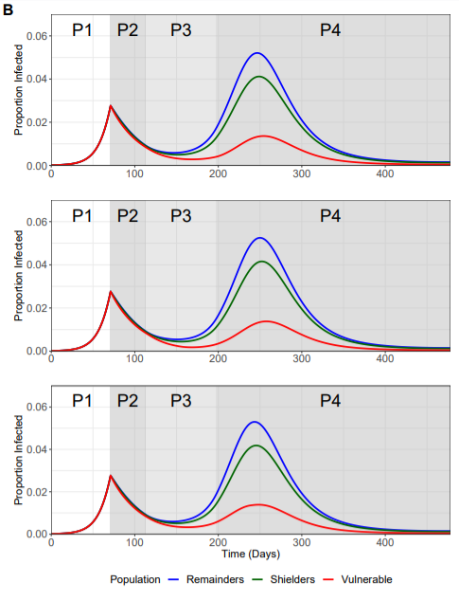

Slide 4
